Slide 1
Conversion of Low Resolution Image to High Resolution Image
K. Ganesh – 2103A52022 K. Durga Preetham – 2103A52185 B. Nithin Reddy – 2103A52046

Slide 2
Agenda
ABSTRACT 3
INTRODUCTION 4
PROBLEM STATEMENT 5
LITERATURE SURVEY 6
OBJECTIVE 8
PROPOSED SOLUTION 9
EXISTING vs PROPOSED 10
RESULTS 11
CONCLUSION 12

Slide 3
Abstract
Our Capstone project focuses on enhancing low-resolution images into high-resolution versions using advanced machine learning techniques, specifically Enhanced Super-Resolution GANs (ESRGANs). ESRGAN, an improved version of Generative Adversarial Networks (GANs), employs a generator-discriminator framework to add fine details and realistic textures while preserving the image's natural look. By training on diverse datasets, the model ensures sharp, visually accurate outputs, making it highly applicable in fields like healthcare, media, and surveillance. Additionally, we have developed a user interface that allows users to upload low-resolution images and view the enhanced results easily. The project aims to deliver a scalable and robust solution for image super-resolution, advancing the quality and usability of degraded visual content. The user interface also enables seamless interaction, allowing users to quickly see the effects of image enhancement, making it accessible and practical for various applications.

Slide 4
Introduction
This project aims to address the challenge of low-resolution images by developing a system that enhances them into high-resolution versions using Enhanced Super-Resolution Generative Adversarial Networks (ESRGAN). ESRGAN, an advanced machine learning method, uses a generator-discriminator framework to restore fine details and realistic textures, producing sharper and more natural images. By improving the clarity and quality of images, this project has practical applications in healthcare, media, and surveillance, making visual content more effective and impactful.

Slide 5
Problem Identification
Many images, such as old photos, medical scans, or blurry security footage, are low-resolution, making them unclear and difficult to use. This limits their usefulness in healthcare, security, and everyday applications. Traditional methods to enhance image quality are often slow and produce unsatisfactory results. This project aims to solve this problem by developing an efficient way to convert low-resolution images into high-resolution ones, preserving clarity and detail for better usability.

Slide 6
Literature Survey
s.no | Authors and Year | Models used | Parameters | Merits | Limitations and drawback
1 | Chao Dong, Chen Change Loy, Kaiming He, Xiaoou Tang (2014) | Super-Resolution Convolutional Neural Network (SRCNN) | MSE loss function (Mean Squared Error) | First deep learning model specifically for super-resolution. Achieves significant improvement over traditional methods (e.g., bicubic interpolation). | Slow training due to the use of raw pixel inputs. MSE loss leads to blurry results since it focuses on minimizing pixel-wise errors without considering perceptual quality.
2 | Jiwon Kim, Jung Kwon Lee, Kyoung Mu Lee (2016) | VDSR (Very Deep Super-Resolution Network) | 20 convolutional layers. Residual learning to speed up training. | Deeper network improves performance significantly compared to SRCNN. Residual learning helps in faster convergence and allows using a deeper network. | High memory consumption due to the deeper architecture. Still suffers from the issue of producing blurred images due to pixel-wise loss function (MSE).

Slide 7
s.no | Authors and Year | Models used | Parameters | Merits | Limitations and drawback
3 | Christian Ledig, Lucas Theis, Ferenc Huszár, et al. (2017) | SRGAN (Super-Resolution GAN) | GAN framework: Generator + Discriminator. Perceptual loss function based on VGG features. | First GAN-based model for super-resolution, generating visually sharper images compared to previous methods. Perceptual loss provides visually appealing, high-resolution images rather than focusing on pixel accuracy. | More complex architecture requiring fine-tuning of adversarial loss and perceptual loss.
4 | Xintao Wang, Ke Yu, Shixiang Wu, et al. (2018) | ESRGAN (Enhanced SRGAN) | Introduced Relativistic GAN. Perceptual loss with better feature extraction (VGG19). | Further improves perceptual quality and sharpness over SRGAN.RRDB removes batch normalization for faster and more stable training.. | Still requires large computational resources for training. Perceptual loss can sometimes result in overly sharp textures that don't match real-world scenes.

Slide 8
Objective
Develop a tool or method to enhance low-resolution images and convert them into high-resolution versions.
Ensure the enhanced images retain essential details and clarity for accurate interpretation and usability.
Provide a solution that is efficient, user-friendly, and adaptable to various applications.
Support industries like Healthcare and security by improving the quality of visual data.
Address the limitations of traditional image enhancement methods with innovative and reliable techniques.

Slide 9
Proposed Solution
This project aims to address the challenge of low-resolution images by developing a system that enhances them into high-resolution versions using Enhanced Super-Resolution Generative Adversarial Networks (ESRGAN). ESRGAN, an advanced machine learning method, uses a generator-discriminator framework to restore fine details and realistic textures, producing sharper and more natural images. By improving the clarity and quality of images, this project has practical applications in fields like healthcare, media, and surveillance, making visual content more effective and impactful.

Slide 10
Existing Method | Proposed Method
Use basic interpolation techniques (e.g., bilinear, bicubic) to estimate new pixels. | Leverages machine learning to analyze and enhance images.
Result in blurry images and lack fine details. | Produces sharper, more detailed results by predicting missing information.
Manual editing is time-consuming and requires expertise. | Automated process requiring minimal user effort.
Limited in predicting and restoring lost details. | Efficient and adaptable for various applications.
Less effective for high-quality image enhancement. | Outperforms traditional methods in clarity and detail restoration.

Slide 11
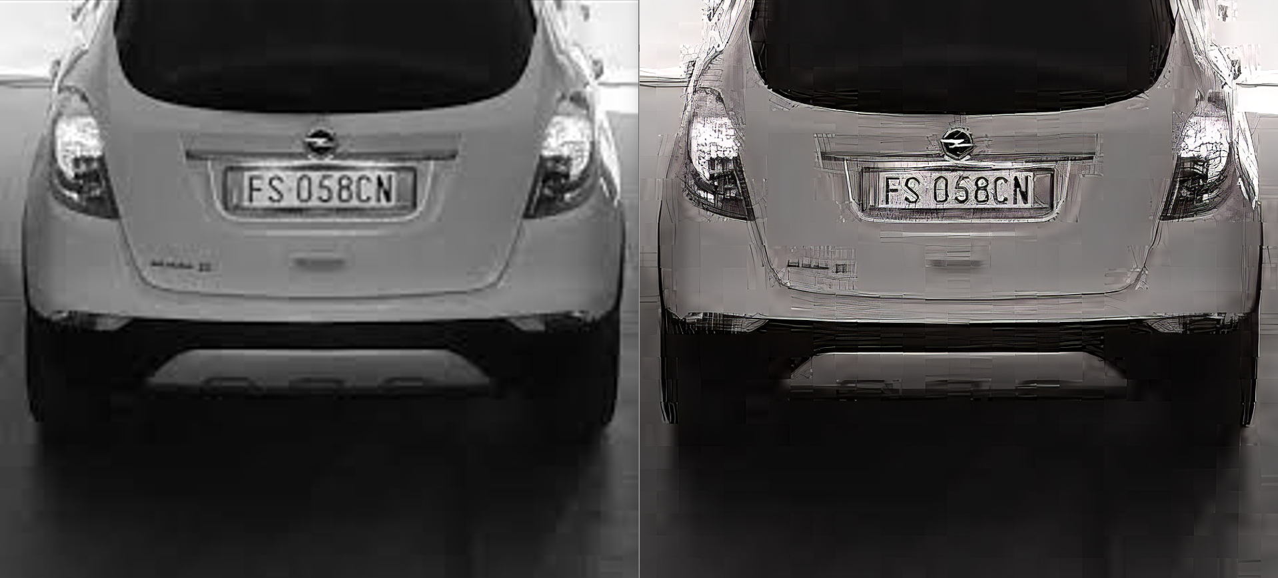
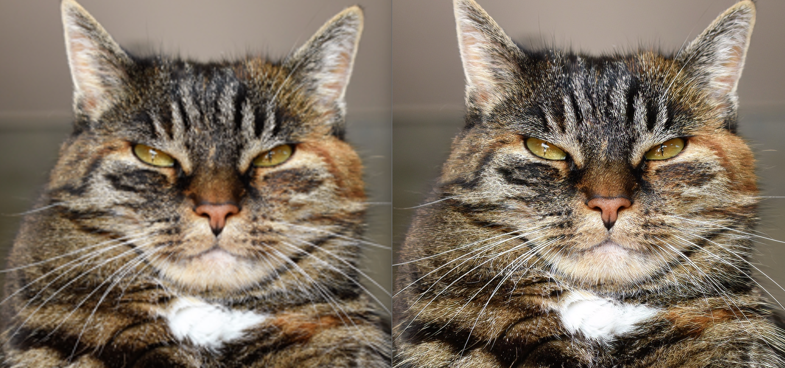
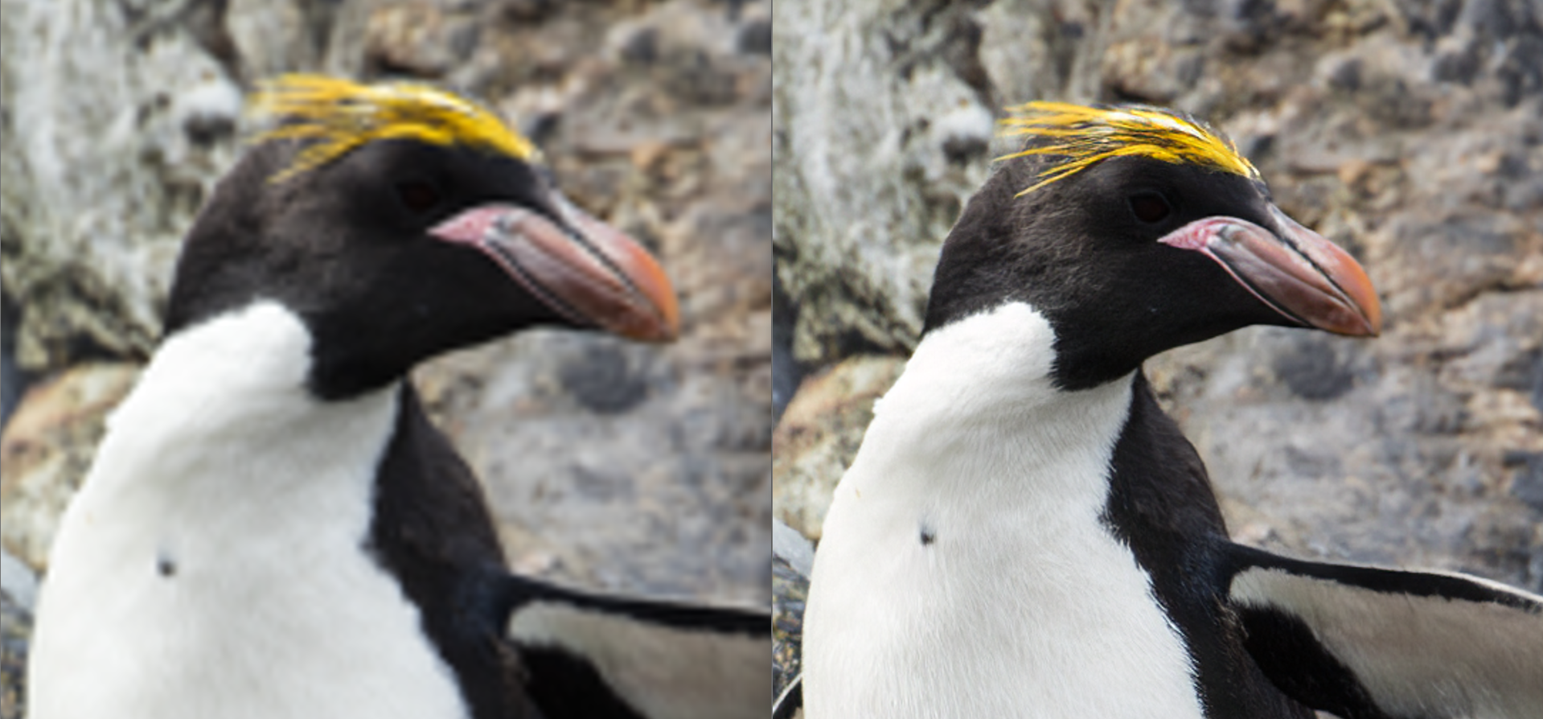
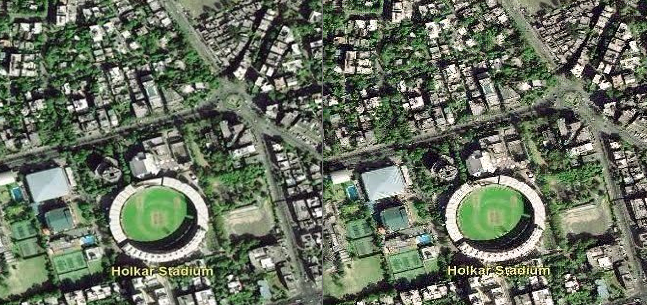
Results

Slide 12
Conclusion
In conclusion, this project introduces a hybrid approach using GANs and diffusion models to revolutionize image super-resolution. By combining the strengths of these advanced technologies, the proposed method delivers sharper details, realistic textures, and minimal artifacts in high-resolution outputs. It outperforms traditional methods with improved metrics such as PSNR, SSIM, and LPIPS, ensuring consistent performance across diverse image types and complex patterns. This solution balances realism and detail recovery, making it a scalable and efficient choice for applications in medical imaging, satellite imaging, and media enhancement. Ultimately, the project sets a new benchmark in super-resolution technology, providing a cutting-edge tool for addressing real-world challenges in image enhancement.

Slide 13
Thank you

